Slide 1
Correlation of Median Age
&
Demographic Factors
Daniel Cucinotta

Slide 2
OUTLINE
A custom dataset of demographic data was developed by scraping 9 webpages operated by 5 organizations; Wikipedia, Brittanica, CIA, Worldometer, and Worlddata.
Raw data was extracted from each page using Python and transformed into tables utilizing Pandas dataframes. Data was manipulated and specific functions were devised to structure, clean, and merge all into a standardized dataset for export, as well as, visualizations within Jupyter Notebook.
Power BI, Tableau, matplotlib, Plotly, and Excel were all employed to display a vast array of visualization types.
OBJECTIVES
Descriptive analytics apropos demographic factors and associations with median age.
Compare and analyze various combinations of attributes with median age.
Discern and delineate patterns as well as outliers.
Distinguish factors that correlate with median age, and potential causality.
Summarize charts and significance as well as coalesce conclusions with insight.

Slide 3
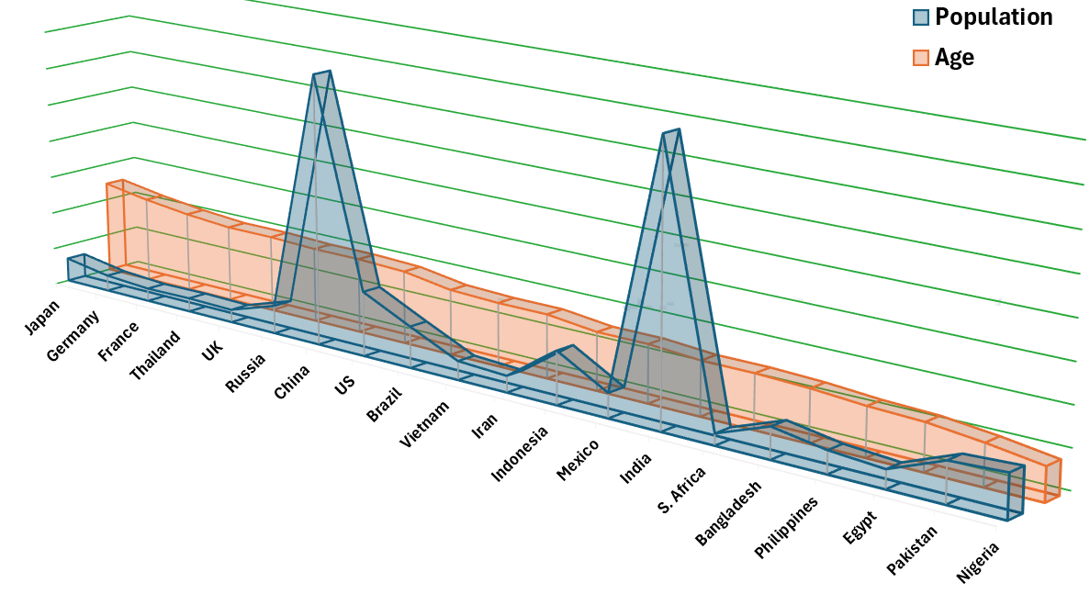
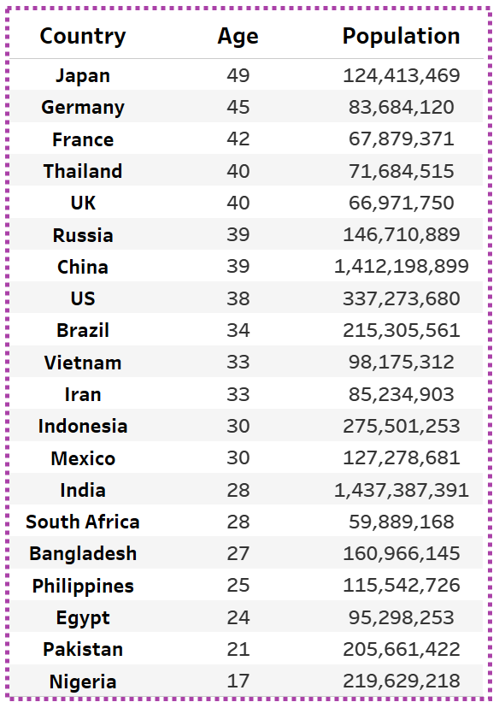
Top 20 Countries Highest Population and Median Age
A correlation between the decrease in age and increase in population is depicted by the relative scale comparison, with several outliers; Japan and Germany have slightly higher populations (and higher median ages), as well as, South Africa has a smaller population comparatively. US has a larger population, and China as well as India have much greater populations.

Slide 4
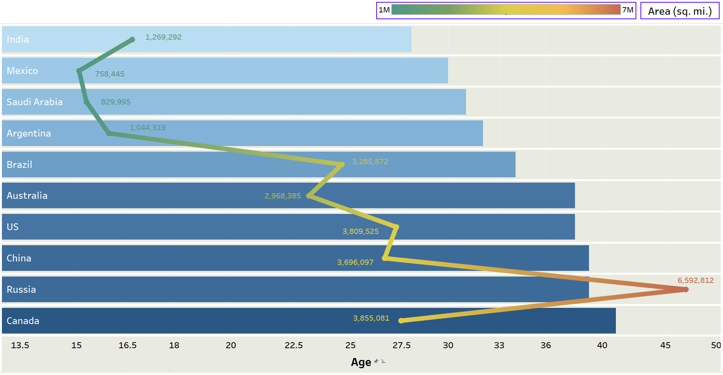
Top 10 Countries by Area and Median Age
A general associative trend can be discerned as the area increases, the median age also increases overall. The only outlier with a significant negative effect is the relatively small size of India and the young median age of 28.

Slide 5
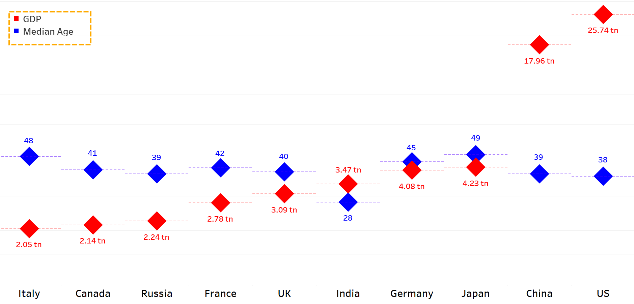
US and China have the highest GDPs, with average national median ages. Japan has the highest median age and 3rd largest GDP in the world. India has the 5th largest GDP and a low median age (28). Germany has the 4th highest GDP and a high median age. The remaining 5 countries display noticeable trends; as the GDP increases, the median age generally decreases relatively. Half of the countries are European nations.

Slide 6
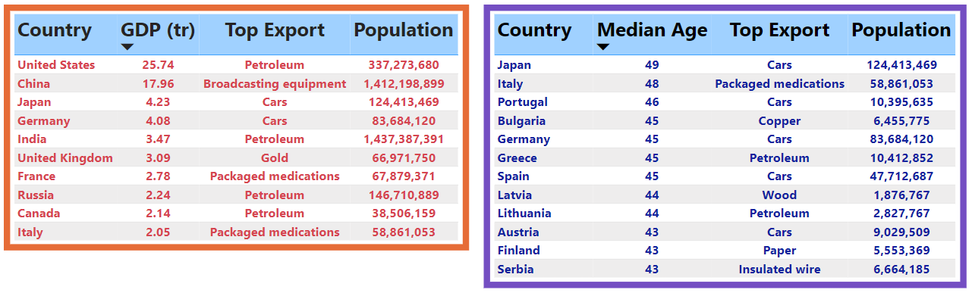
Petroleum is the top export from 4 of 10 countries by highest GDP and are the top 4 countries with the greatest area size. The top export from 5 of 12 countries by highest median age is cars, and only 2 countries primarily produce oil for export. Japan has the highest median age in the world, and the 10 subsequent highest median age countries are located in Europe.

Slide 7
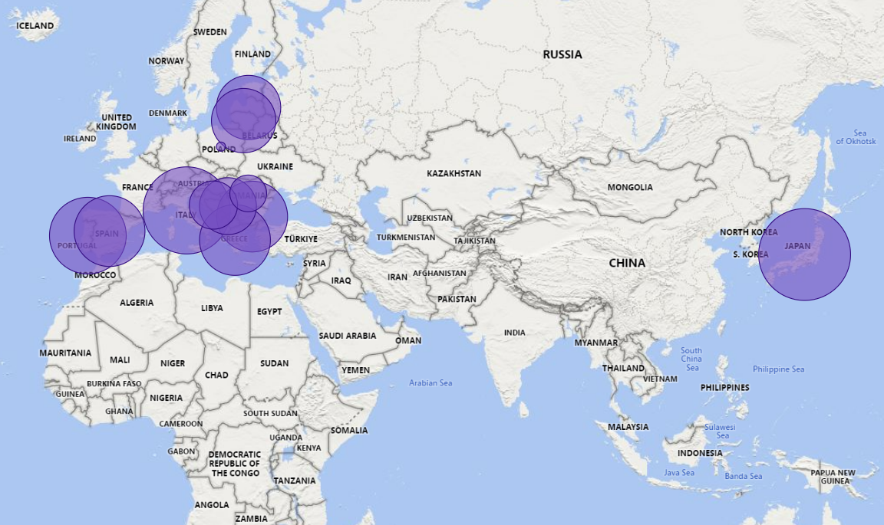
Top 12 Countries Median Age Greater Than 40 by Income Less Than 45,000
Japan has the highest median age in the world (49; represented by bubble size) and is geographically isolated from the remaining 10 (located in Europe), in which more than half are situated around the Adriatic Sea region of the Mediterranean.

Slide 8
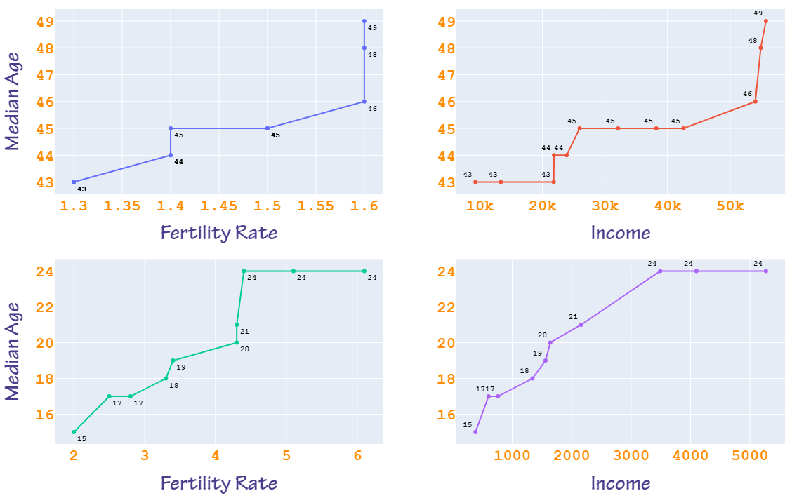
Income and fertility rate have different scales by median age, highlighting a definitive correlative relationship. The higher median age range is representative of Japan and European nations. Fertility rate and income increase as the median age rises. For ages 46 – 49, the fertility rate is 1.6%, which is the highest for the age range. For ages 15 – 24, the fertility rate and income have similar ascending trajectories, which both plateau at age 24.

Slide 9
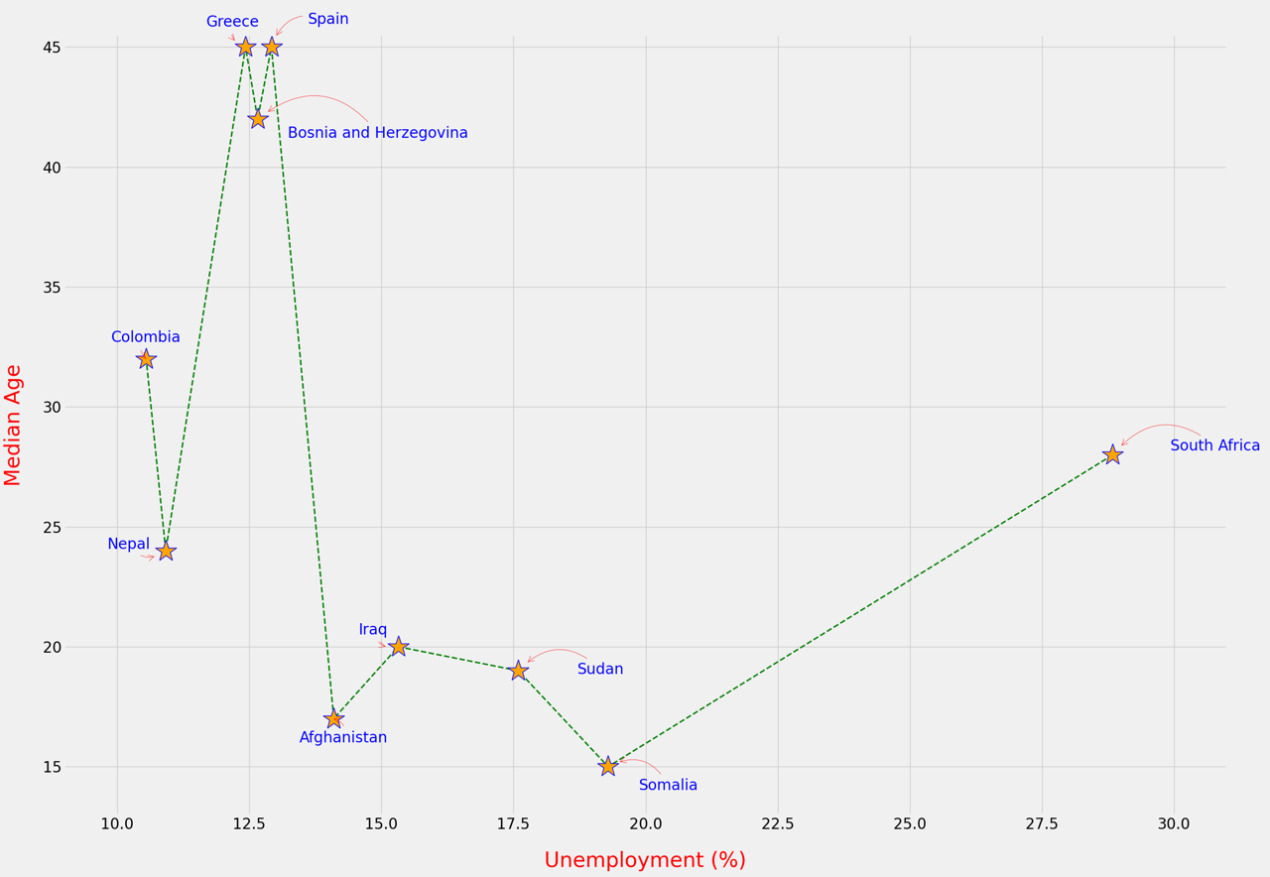
There is an association between high unemployment rate and low median age. Somalia, Sudan, Iraq, and Afghanistan have a significantly low age range of 15 – 20 years old. The median age in South Africa (28) is nearly double the median age of Somalia (15), which is the youngest in the world, yet has more than 1/3rd higher unemployment rate.

Slide 10
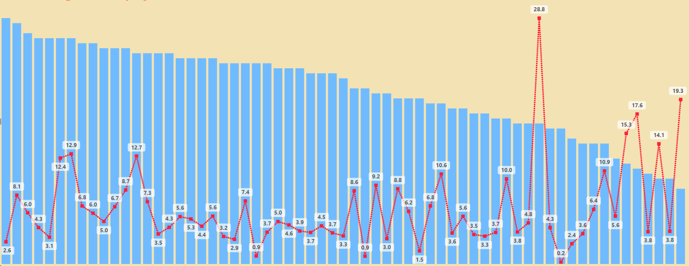


The median age decreases from 49 (Japan) to 15 (Somalia); Japan has the highest median age and a low unemployment rate of 2.6%. A steady upslope for the unemployment rate (with many fluctuations) as the median age decreases. There are only 5 country unemployment rates less than the 2.6% (Japan) on the upward trend, and South Africa is a significant outlier (28.8%). 4 of the 6 lowest median age countries have greater than 14% unemployment; Somalia, has the lowest median age and the 2nd highest unemployment rate (19.3% ).

Slide 11
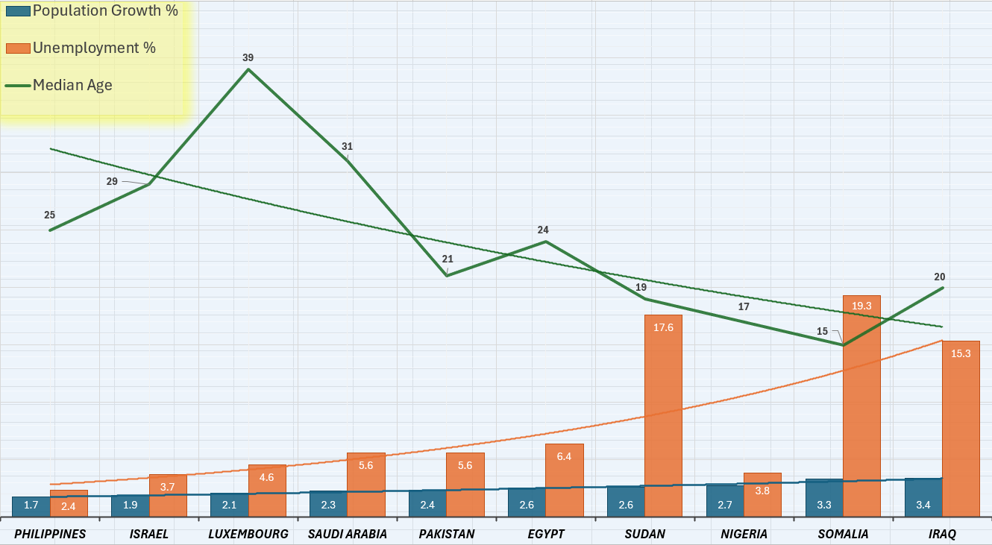
Top 10 Countries Population Growth by Unemployment and Median Age
Top 10 Countries Population Growth by Unemployment and Median Age
The converging trend lines display a direct correlation of increasing population growth and unemployment rate with a decreasing median age. The upward unemployment slope has only 3 significant outliers; Sudan and Somalia are higher, and Nigeria is lower, comparatively. Luxembourg has the highest median age and is the fastest growing country in Europe.

Slide 12
Analysis Summary
There are several demographic factors that have a general interconnection with median age:
Population - Increase in population, decrease in age.
Area – Increase in area, increase in age.
GDP – Increase in GDP, decrease in age.
Location – Japan, and countries located in Europe (central and western).
Fertility Rate – Increase in age, increase in fertility (by age range).
Income – Increase in age, increase in income (by age range).
Unemployment – Increase in unemployment, decrease in age.
Population Growth – Increase in population growth, decrease in age.
Population:
The 3 most populated countries are India, China, and the US, respectively, which have a median age range of 28 – 38.
Brazil, Indonesia, Pakistan, and Nigeria all have populations greater than 200 million people and a low median age range of 17 – 34.

Slide 13
Analysis Summary
Area:
Russia has the largest area of 6.5 million square miles and a median age of 39.
The most populated country in the world is India (1.44 bn) and it is the 7th largest by area (1/5th the size of Russia), which can be a resulting factor for the low median age of 28.
China (2nd largest population - 1.41 bn), Canada, US, and Australia have a median age range of 38 – 41 and approximately 1/2 the area of Russia.
GDP:
All top 10 highest GDP countries have a Median age range 38 – 49, except India (28).
The top export from 5 of 12 countries by highest median age is cars.
Petroleum is the top export from 4 of 10 countries by highest GDP, and China is also one of the worlds largest oil producers. All stages of petroleum production have direct negative effects and hazards for tradespersons as well as environmental toxicity, affecting living organisms within a proximity, resulting in increased illnesses, diseases, and deaths.

Slide 14
Analysis Summary
Location:
Japan has the highest median age in the world and is geographically isolated from the next 10 countries, which are all located in Europe, and more than half are situated around the Adriatic Sea region of the Mediterranean.
Japan has an expansive latitude span of 32° - 45° N as well as 8 of the10 European countries are also within the range of 39° - 44° N.
Fertility Rate and Income:
An associative relationship exists between the increase in age and the similitude of increasing fertility rate and income, relative to independent minimum and maximum age ranges / scales.
The lower median age range (15 – 24) is representative of African and Central Asian nations, in which the fertility rate and income gradually ascend from ages 15 - 21, with both having the greatest increases at age 24 .
The higher median age range (43 – 49) is representative of Japan and the European nations, in which the fertility rate increases steady from ages 43 – 45. The highest fertility rate plateaus for ages 46 – 49 (1.6%).

Slide 15
Analysis Summary
Unemployment:
There is an association between high unemployment rate and low median age.
Somalia, Sudan, Iraq, and Afghanistan have a significantly low median age range of 15 – 20 years old. The unemployment rate in South Africa is more than 1/3rd higher than Somalia, though nearly double the median age of 15 (youngest in the world).
South Africa has a productive economic system, yet income and racial inequality are pervasive factors. Most of the top 10 countries by unemployment rate has endured terrorism, civil unrest, conflicts, and / or war, as well as, forced government and regime changes, such as Somalia, Sudan, Iraq, and Afghanistan, which results in dangerous living conditions and less jobs.
Population Growth:
There is a direct correlation of increasing population growth and unemployment rate with a decreasing median age.

